Slide 1
CPE 10 FUNDAMENTALS OF MIXED SIGNALS AND SENSORS
BSCPE III GE – MW 7:30 – 9:00 BSCPE III GF – TTH 7:30 – 9:00
ENGR. JOEL ANTHONY L. SEVILLA
JANUARY 2024

Slide 2
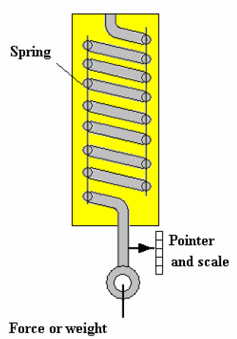
V. FORCE SENSORS
MECHANICAL TYPES
It is a basic mechanical principle that the deflection of a spring is directly proportional to the applied force so if the movement is shown on a scale, the scale represents force.

Slide 3
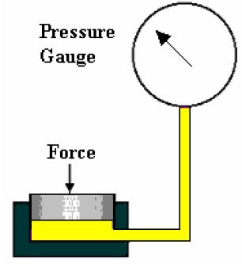
HYDRAULICS TYPE
Are often referred to as hydraulic load cells. The cell is a capsule filled with liquid. When the capsule is squeezed, the liquid becomes pressurized. The pressure represents the force and may be indicated with a calibrated pressure gauge. The capsule is often a short cylinder with a piston.

Slide 4
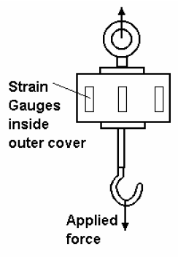
ELECTRICAL STRAIN GAUGE TYPE
A typical load cell consists of a metal cylinder with strain gauges fixed to it. When the cylinder is stretched or compressed, the strain gauges convert the force into a change in resistance and voltage. Since the elements require a supply voltage, the cell usually has 4 wires, two for the supply and two for the output.

Slide 5
VI. POSITION SENSORS
Position sensors are essential elements in the control of actuators. The position of both linear and rotary actuators is needed in robotic type mechanisms.
Three principle types:
RESISTIVE
OPTICAL
INDUCTIVE

Slide 6
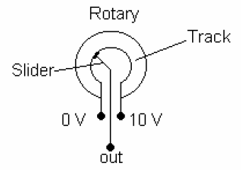
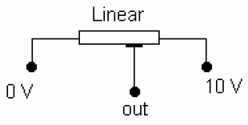
RESISTIVE TYPES
A potentiometer is a variable electrical resistance. A length of resistance material has a voltage applied over its ends. A slider moves along it (either linear or rotary) and picks off the voltage at its position or angle.

Slide 7
The tracks may be made from carbon, resistance wire or piezo resistive material. The latter is the best because it gives a good analog output.
The wire wound type produces small step changes in the output depending on how fine the wire is and how closely it is coiled on the track.

Slide 8
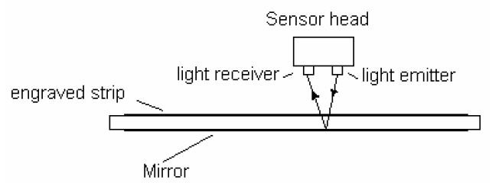
OPTICAL TYPES
Optical types are mainly used for producing digital outputs. A common example is found on machine tools where they measure the position of the work table and display it in digits on the gauge head.

Slide 9
Light is emitted through a transparent strip or disc onto a photo electric cell. The strip or disc has very fine lines engraved on it which interrupt the beam. The number of interruptions are counted electronically and this represents the position or angle.

Slide 10
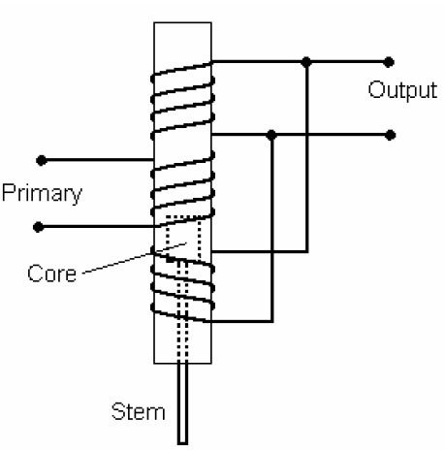
INDUCTIVE TYPES
The most common of these is the Linear Variable Differential transformer or LVDT. The transformer is made with one primary coil and two secondary coils, one placed above and the other below the primary.

Slide 11
The coils are formed into a long narrow hollow tube. A magnetic core slides in the tube and is attached to the mechanism being monitored with a non magnetic stem (e.g. brass).
A constant alternating voltage is applied to the primary coil. This induces a voltage in both secondary coils. When the core is exactly in the middle, equal voltages are induced and they cancel each other out.

Slide 12
When the core moves, the voltage in one secondary coil grows but reduces in the other. The result is an output voltage which represents the position of the core and the mechanism to which it is attached. With suitable electronic equipment for phase detection, it is possible to detect which direction the core moves and to switch the dc voltage from plus to minus as the core passes the center position.

Slide 13
VII. DEPTH GAUGES
Depth gauges measure the depth of liquids and powder in tanks. They use a variety of principles and produce outputs in electrical and pneumatic forms. The type to use depends on the substance in the tank.

Slide 14
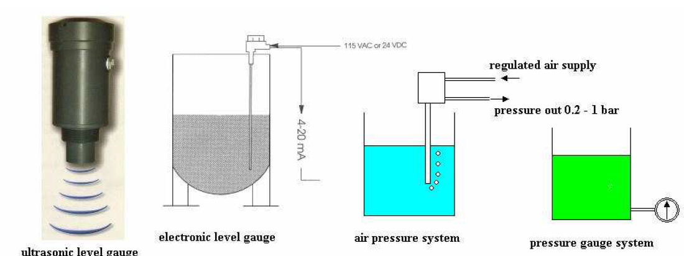
The ultrasonic system reflects sound waves from the surface and determines the depth from the time taken to receive the reflected sound.

Slide 15
The electronic version uses a variety of electrical affects including conduction of the fluid and capacitance.
The pneumatic version bubbles air through the liquid and the pressure of the air is related to the depth. A simple pressure gauge attached to a tank also indicates the depth since depth is proportional to pressure.

Slide 16
VIII. PHOTOELECTRIC TRANSDUCERS
Converts the incoming light source into electrical energy, normally made of semiconductor materials.
Categorized as photo emissive, photoconductive or photovoltaic.

Slide 17
PHOTOCONDUCTIVE CELLS
A photoconductive cell varies resistance with the intensity of light.
Like a common resistor, a photoconductive cell has no polarity and can be placed into the circuit in either direction.

Slide 18
PHOTOCONDUCTIVE CELLS
Generally made of cadmium compounds such as Cadmium Sulphide (CdS) and Cadmium
Selenide (CdSe).
Spectral response of CdS cell is similar to the human eye hence it is often used to simulate the
human eye.

Slide 19
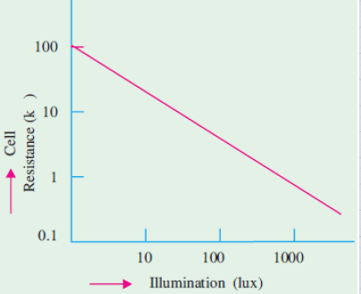
Working Principle
Typically, the dark resistance
of the cell is 1 MΩ or
larger under illumination,
the cell resistance drops to
a value between 1 and
100 kΩ depending on
surface illumination.

Slide 20
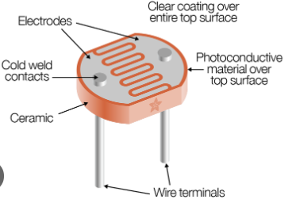

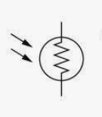

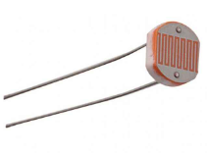
aka Photo cells,
Photo resistors,
Photo resistive
device, & light
detecting resistor.

Slide 21
Photoconductive materials most frequently used:
Cadmium Sulfide (CdS) = 5100 Å
Cadmium Selenide (CdSe) = 6150 Å
Response time
CdS = 100 ms
CdSe = 10 ms

Slide 22
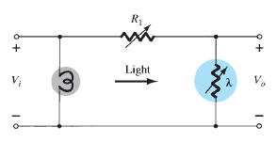

APPLICATIONS
inexpensive and simple detector which is widely used in OFF/ON circuits, light measurement, and light-detecting circuits.

Slide 23
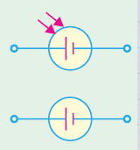
PHOTOVOLTAIC CELLS (PVC)
Photo Voltaic Cells or solar cells produce a voltage when subjected to light energy.
The greater the light intensity, the greater amount of voltage produced.

Slide 24
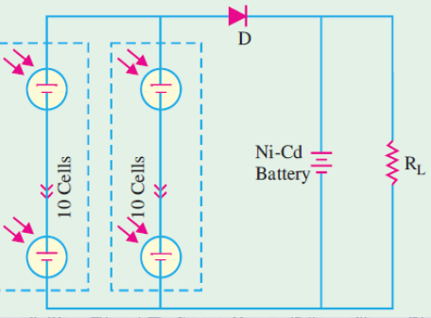
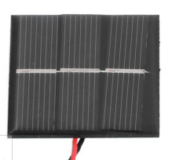
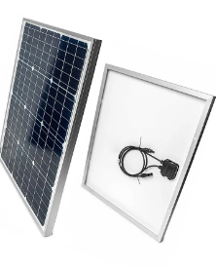
Solar cells act like a battery when connected in series or parallel.

Slide 25
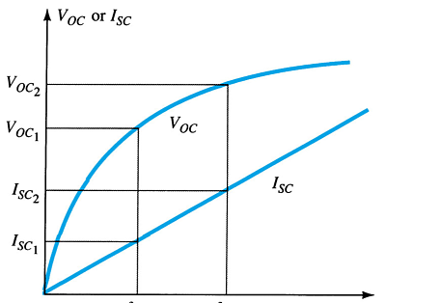
CHARACTERISTICS
Operates with fair efficiency.
Has unlimited life.
Can be easily mass produced.
Has a high power capacity
per weight.

Slide 26
LIGHT EMITTING DIODE (LED)
A semiconductor device that emits light when forward bias.
Generally uses Gallium Arsenide Phosphide (GaAsP) and Gallium Phosphide (GaP)
Light is produced as the electrons and holes are recombined and releases energy.

Slide 27
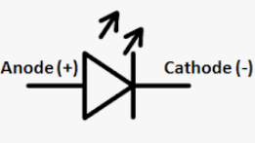
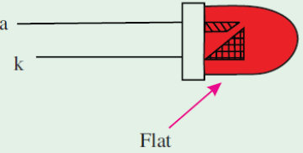
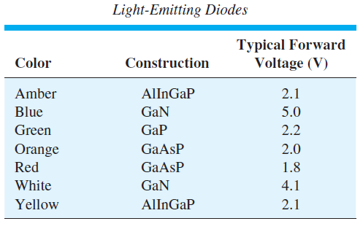
max forward voltage
= 1.2 V to 3.2 V
depending on the device
reverse breakdown voltage
= 3 V to 10 V
The amount of power output
translated into light is directly proportional to the forward current.

Slide 28
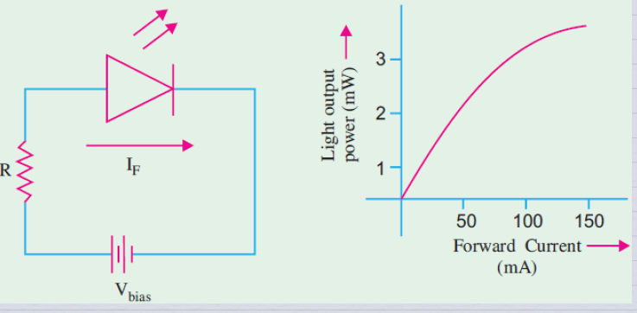
LED biasing and characteristic curve

Slide 29
LED APPLICATIONS
burglar-alarm systems
solid-state video displays
image sensing circuits
fiber optics
data links and remote controllers
seven segment displays
numeric displays

Slide 30
SEVEN-SEGMENT DISPLAY
Consists of 7 rectangular LEDs which can form alphanumeric figures.
LED segments are labelled 'a' to 'g'
In common-cathode type, all the cathodes of the diodes are tied together.
In common-anode type, all its anodes are tied together to +5 volts and ground is used to light the individual segments

Slide 31
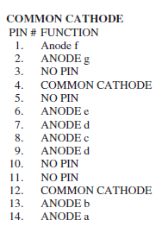
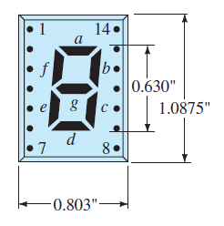
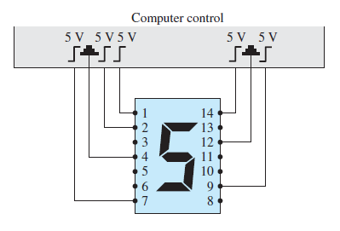
SEVEN-SEGMENT DISPLAY
Example: to light number 5, segments a, f, g, c, and d must be forward-biased; only 5 volts is to be applied to the anode of these segments to light them.

Slide 32
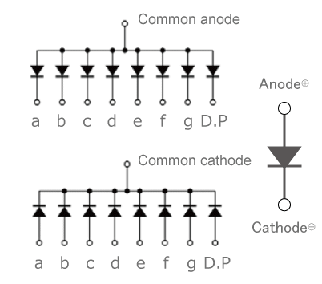
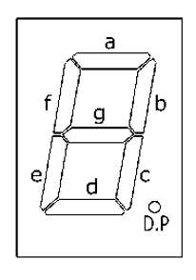

SEVEN-SEGMENT DISPLAY

Slide 33
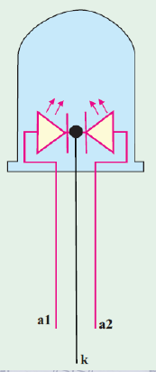
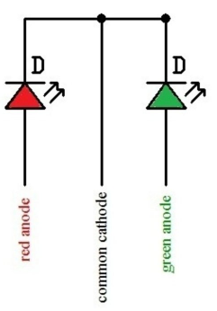

TWO-COLOR LEDs
When leads R and C are
forward-biased,
the LED emits red light.
When leads G and C are
forward-biased,
LED emits green light.

Slide 34
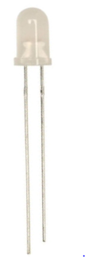
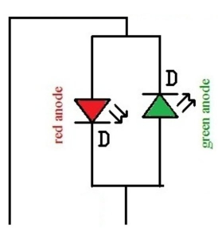
THREE-COLOR LEDs
It has two leads that acts
as both anode and cathode.
When dc current flows through
one direction, it emits red light,
but when the current flows in
the opposite direction, the LED
emits green light. With ac current,
yellow light is given out.

Slide 35
BLINKING LEDs
Combination of an oscillator and an LED in one package.
Looks like an ordinary LED.
Blinking frequency is usually 3 Hz when the diode forward bias is 5 V.
Conducts about 20 mA of current when ON and 0.9 mA when OFF.

Slide 36
LIQUID CRYSTAL DISPLAYS (LCD)
The background is either light or dark, when a voltage is applied to a segment, then the alphanumeric display is visible. The amount of voltage necessary for display varies depending on the type of display, from 2 to 20V.
Low power LCDs require less power than LEDs. But LEDs have faster response times and longer life.

Slide 37
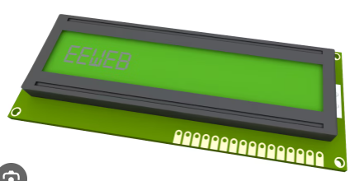

A liquid crystal is a material (usually
an organic compound) which flows
like a liquid at room temperature
but whose molecular structure has
some properties normally
associated with solids.

Slide 38
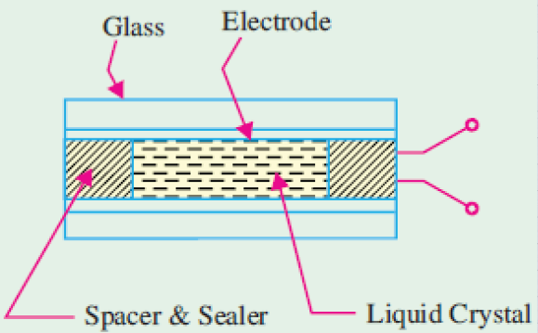
A thin layer of liquid crystal is transparent to incident light. When light falls on an activated (exposed to electricity) layer of a liquid crystal, it is either absorbed or
else is scattered by the
disoriented molecules.

Slide 39
LCD Construction
A liquid crystal 'cell' consists of a thin layer (about 10 um) of a liquid crystal sandwiched between two glass sheets with transparent
electrodes deposited on their inside faces.
With both glass sheets transparent, the cell is known as transmitive type cell.

Slide 40
LCD Construction
When one glass is transparent and the other has a reflective coating, the cell is called a reflective type.
The LCD does not produce any illumination of its own. It depends entirely on illumination falling on it from an external source for its visual effect.

Slide 41
Operating Condition
When field-effect display is energized, the energized areas of the LCD absorb the incident light and hence, give a localized black display.
When dynamic scattering display is energized, molecules of energized area of the display become turbulent and scatter light in all directions. The activated areas take on a

Slide 42
Operating Condition
frosted glass appearance resulting in a silver display. The un-energized areas remain translucent.

Slide 43
ADVANTAGES
Extremely low power requirement, about 10 - 15 μW per 7-segment display as compared to a few mW for an LED.
Lifetime of about 50,000 hours (around 5.7 yrs)
watches and portable instruments (field-effect LCDs).

Slide 44
PHOTODIODE
The photodiode is a semiconductor pn junction device whose region of operation is limited to the reverse-bias region.
The dark current refers to the current that flows when no light is incident.
A photodiode can turn its current ON and OFF in nanoseconds; it is one of the fastest photodetectors.

Slide 45
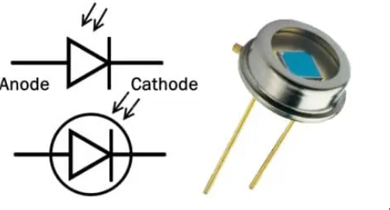
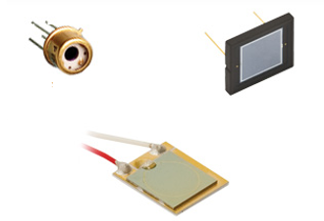

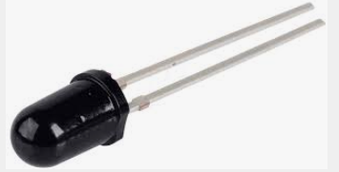
Symbols and commercially available components

Slide 46
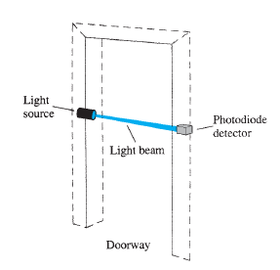
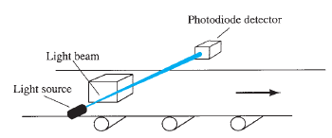
APPLICATION
Instrumentation circuits as a sensor
Alarm system sensor
Detection of objects on a conveyor belt
Photodiode used in alarm system and conveyor

Slide 47
IR EMITTERS
Diodes that emit infrared radiation.
IR emitter produce infrared radiation when forward biased. The higher the forward bias current, the greater the intensity of infrared radiation.
The radiation pattern can vary from widely dispersed to a very narrow, focused beam.

Slide 48
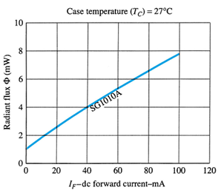
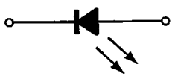

Applications
Card readers
Shaft encoders
Intrusion alarms
IR Transmitters

Slide 49
LASER DIODE
Laser diodes have a threshold level of current above which the laser action occurs but below which the laser diode behaves like a LED
emitting incoherent light.
It is coherent – there is no path difference between the waves comprising the beam.
It is monochromatic – it consists of one wavelength and hence one color only.

Slide 50
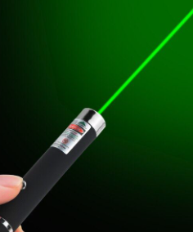
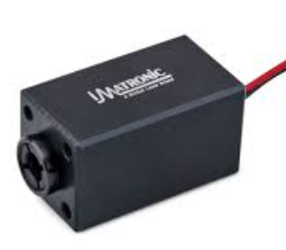
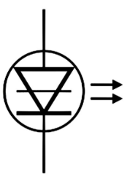
LASER DIODE
It is collimated i.e. emitted light waves travel parallel to each other.
A filter or lens is necessary to view the laser beam.

Slide 51
APPLICATIONS
used in variety of applications ranging from medical equipment used in surgery to consumer products like optical disk equipment, laser
printers, hologram scanners etc.
Laser diodes emitting visible light are used as pointers.
Those emitting visible and infrared light are used to measure range (or distance).

Slide 52
APPLICATIONS
The laser diodes are also widely used in parallel processing of information and in parallel interconnections between computers.

